Slide 1
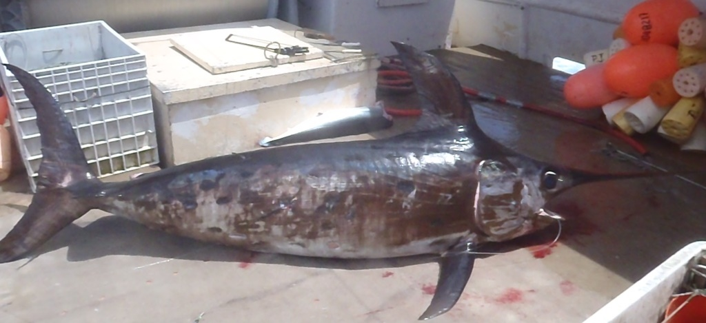
U.S. Swordfish Fisheries in the North Pacific Ocean
Pacific Islands Fisheries Science Center
Fisheries Research & Monitoring Division
Russell Ito
NOAA Pacific Islands Fisheries Science Center
and
Yuhong Gu
NOAA Southwest Fisheries Science Center
ISC Billfish Working Group Meeting
Yokohama, Japan, November28-30 & December 5, 2022

Slide 2
Swordfish Catch by Gear Type
Pacific Islands Fisheries Science Center
Fisheries Research & Monitoring Division
Notes:
U.S. NPO Total = 766 mt in 2021
Longline = 690 mt
Gill net =13 mt
Harpoon = 7
Buoy = 49 mt

Slide 3
Number of California Harpoon Vessels
Pacific Islands Fisheries Science Center
Fisheries Research & Monitoring Division
Notes:
CA Harpoon vessels = 11 in 2021
Activity highest in the earlier years
Lowest level is in most recent 10 years

Slide 4
California Harpoon Swordfish CPUE
Pacific Islands Fisheries Science Center
Fisheries Research & Monitoring Division
Notes:
High variability in harpoon CPUE
Aircraft assistance (green) much higher CPUE
CPUE with no assistance (red) high in recent years

Slide 5
Number of California Drift Gill Net Vessels
Pacific Islands Fisheries Science Center
Fisheries Research & Monitoring Division
Notes:
Downward trend for gill net vessel activity
Record low 6 vessels in 2021

Slide 6
California Drift Gill Net Swordfish CPUE
Pacific Islands Fisheries Science Center
Fisheries Research & Monitoring Division
Notes:
Gill net CPUE relatively steady from 1983-84 thru 2014-15
CPUE spikes in 2016-17
CPUE = 2.0 fish in 2021

Slide 7
Pacific Islands Fisheries Science Center
Fisheries Research & Monitoring Division
Number of U.S. Longline Vessels
Notes:
Total U.S. longline vessels trending up with 146 vessels in 2021 (Lt blue)
Shallow-set vessels for SWO trending down with slight increase from 2018 to 17 vessels in 2021 (Dk blue)

Slide 8
Pacific Islands Fisheries Science Center
Fisheries Research & Monitoring Division
U.S. Longline Swordfish Catch by Area, 2021
Notes:
Highest catches above the Hawaiian Islands
Swordfish catch south of islands too

Slide 9
Pacific Islands Fisheries Science Center
Fisheries Research & Monitoring Division
U.S. Longline Nominal Swordfish CPUE
Notes:
Nominal swordfish CPUEs
Shallow-set CPUE 100x’s higher than deep-set CPUE
Shallow-set CPUE 10-15 fish during 1991-2000
Regulations created uncertainty in shallow-set fishing during 2001-2004
Reopened in 2004 with spike in 2006 due to closure from turtle interactions
Drops thru 2009, gradually increases thru 2017 and more recently, declines to record low 7 fish
Deep-set CPUE drops in earlier years, remains low after 1996 with CPUE at 0.06 in 2021.

Slide 10
U.S. Longline Swordfish CPUE by Quarter
Pacific Islands Fisheries Science Center
Fisheries Research & Monitoring Division
Shallow-set Swordfish CPUE
Deep-set Swordfish CPUE
Notes:
Shallow-set CPUE highest in Q1
Not enough data in 2020, No effort in Q3 2021
Deeps-set CPUE highest in Q2
Not enough data in 2020

Slide 11
U.S. Longline Swordfish Weight-Frequency Histograms, 2021
Pacific Islands Fisheries Science Center
Fisheries Research & Monitoring Division

Slide 12
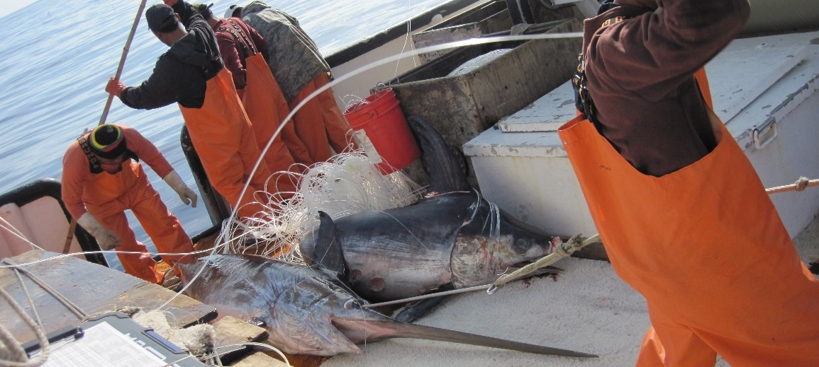
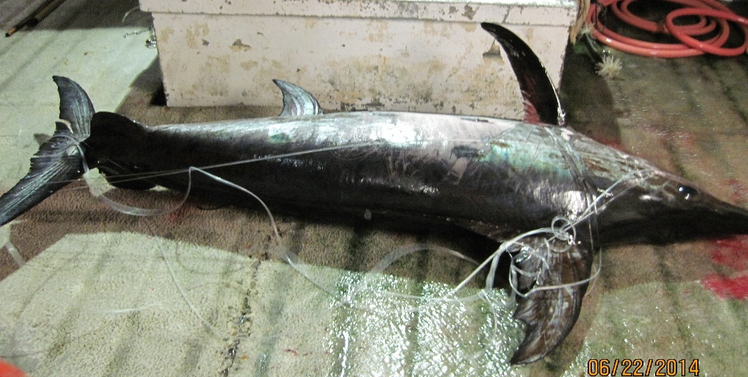
Overview of U.S. Fisheries for Swordfish in the North Pacific Ocean
Pacific Islands Fisheries Science Center
Fisheries Research & Monitoring Division
*U.S. fisheries for swordfish in the NPO accounted for 35% of the national harvest
*Longline fishery is the largest commercial fishery for swordfish
*There are differences in effort, area fished, CPUE & size of fish between the shallow- & deep-set longline fisheries.
*California harpoon and drift gillnet swordfish fisheries continue to decline with “buoy gear” as a alternative method of fishing.

Slide 13
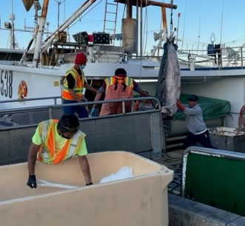
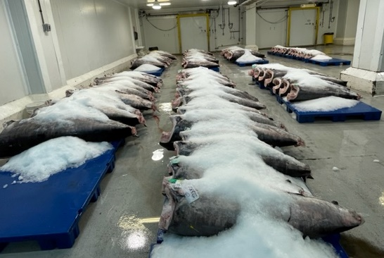
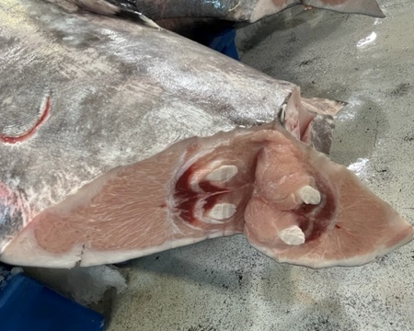
Recent Developments
Pacific Islands Fisheries Science Center
Fisheries Research & Monitoring Division
*Shallow-set longline sea turtle interactions below limits from 2011
*Catches of swordfish by the deep-set longline fishery increasing
*Hawaii-permitted longline vessels continue to operate out of California
*Less interest in swordfish due to high tuna prices and difficulty air- freighting fish out of Hawaii

Slide 14
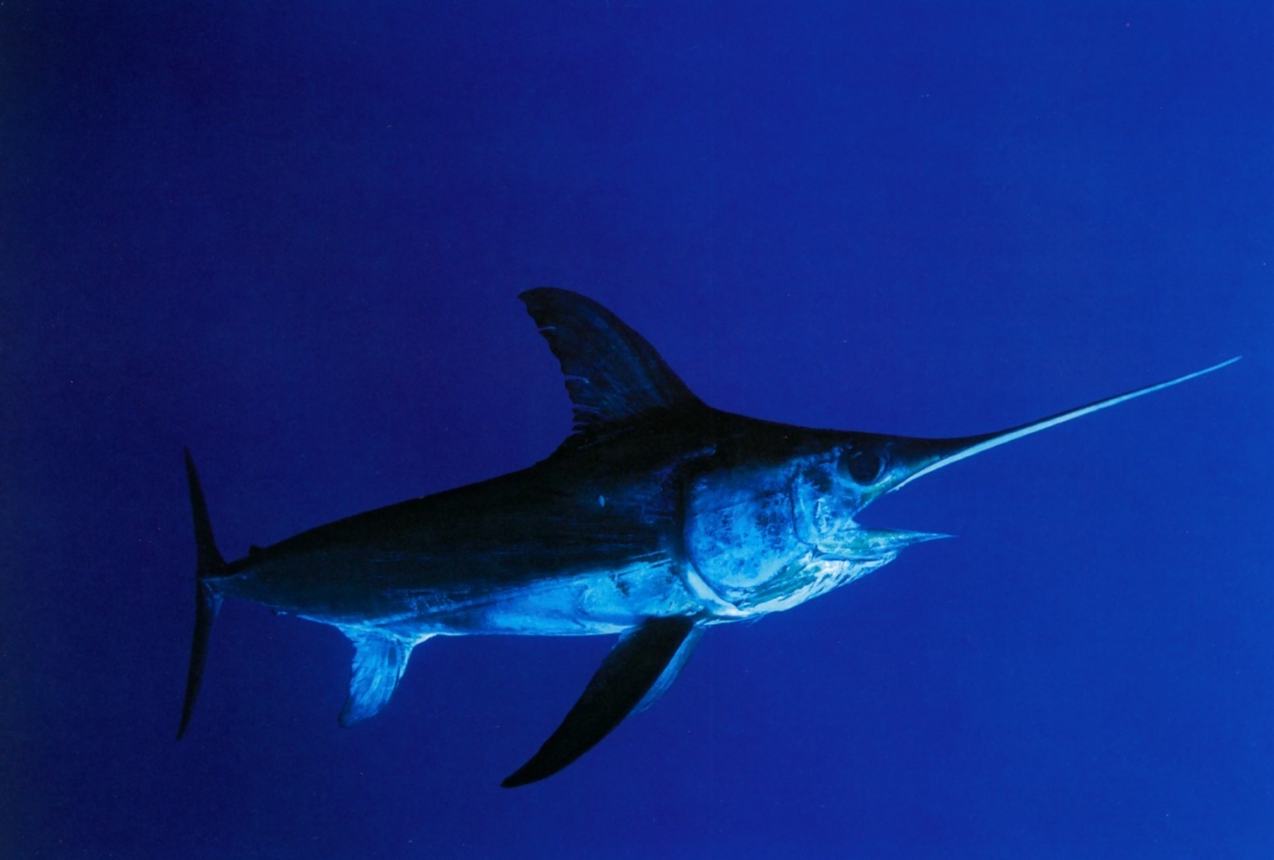
Acknowledgements
Pacific Islands Fisheries Science Center
Fisheries Research & Monitoring Division
Fisheries Monitoring Program-Nate Chan, Walter Machado & Emmeline Kalahiki
Fisheries Reporting and Bycatch Program-Ashley Tomita & Keith Bigelow
U.S. Longline Fishermen
Honolulu Auction and Seafood Buyers

